Slide 1
A NEW ALGORITHM TO CORRECT FISH-EYE- AND STRONG WIDE-ANGLELENS-
DISTORTION FROM SINGLE IMAGES
Christian Brauer-Burchardt and Klaus Voss
Proceedings of International Conference on Image Processing, 2001. pp. 225-228, vol.1
Date: Dec. 5, 2007
Introducer: Chung-Han Chiang

Slide 2
Abstract
The use of super-wide angle and fish-eye lenses causes strong distortions in the resulting images. A methodology for the correction of distortions in these cases using only single images and linearity of imaged objects is presented in this work. Contrary to most former algorithms, the algorithm discussed here does not depend on information about the real world co-ordinates of matching points. Moreover reference points determination and camera calibration is not required in this case.
The algorithm is based on circle fitting. It requires only the possibility of the extraction of distorted image points from straight lines in the 3D scene. Further, the actual distortion must approximately fit the chosen distortion model. For most fish-eye lenses appropriate distortion correction results can be obtained.

Slide 3
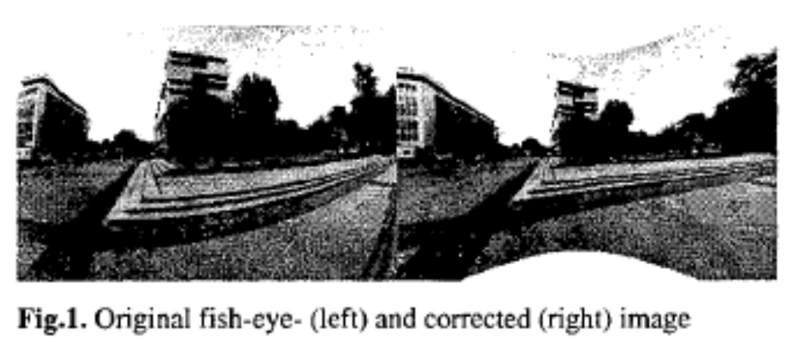
Introduction

Slide 4


Model
P’(X’ , Y’)
P(X , Y)
Distance = r’
Distance = r
t’ (x’ , y’)
t (x , y)

Slide 5
The principle point
In a computer vision, the principle point is defined as the point where the optical axis of the lens intersects the image plane of the CCD camera. This is the so-called optical centre or image centre, which is usually used as the origin of the image coordinate system.

Slide 6
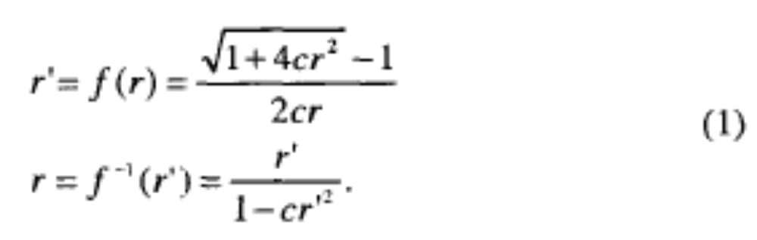
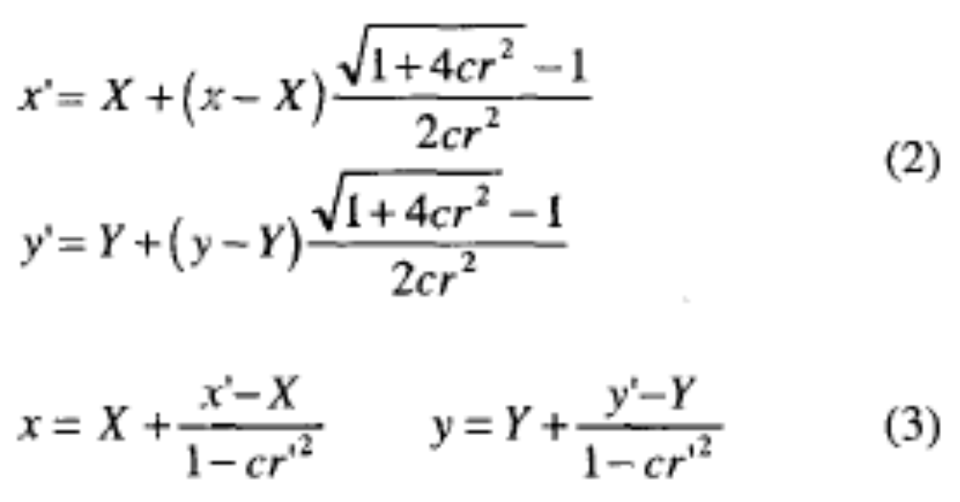

Slide 7
P(X , Y)
g
t (x , y)
f (x_{f} , y_{f})
Reformulation

Slide 8


Applying (3) to (5) and setting u² = (X-x_{f’})²‧( Y - y_{f’})² we get by the equation of a circle in general form.
Thus any straight line g not intersecting P is transformed into a circle with some radius p and centre by the radial lens distortion.

Slide 9
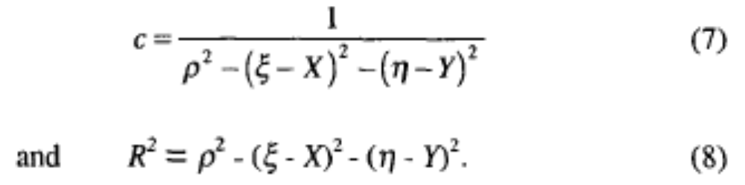

Slide 10
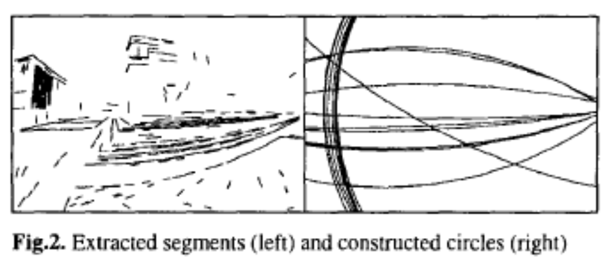
Algorithm
1. We use an edge detection algorithm.
2. Assuming that the segments approximate the circle, the segments belonging to the same circle have the same distance to the centre of the circle. This test is performed by determining the intersection of the perpendicular bisectors of the two segments.

Slide 11
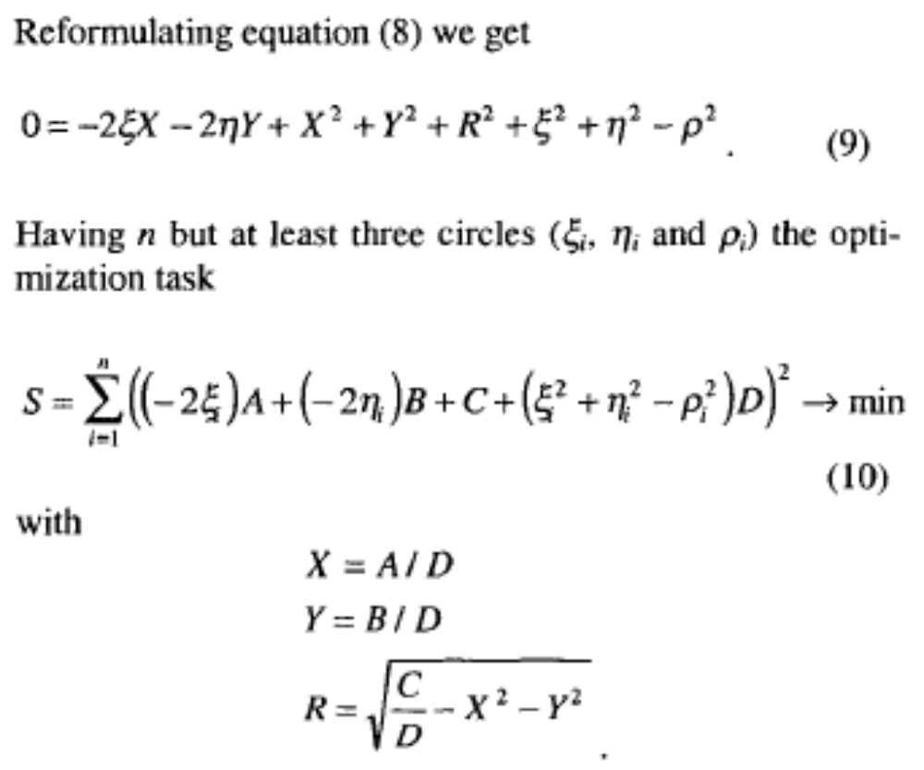

Slide 12
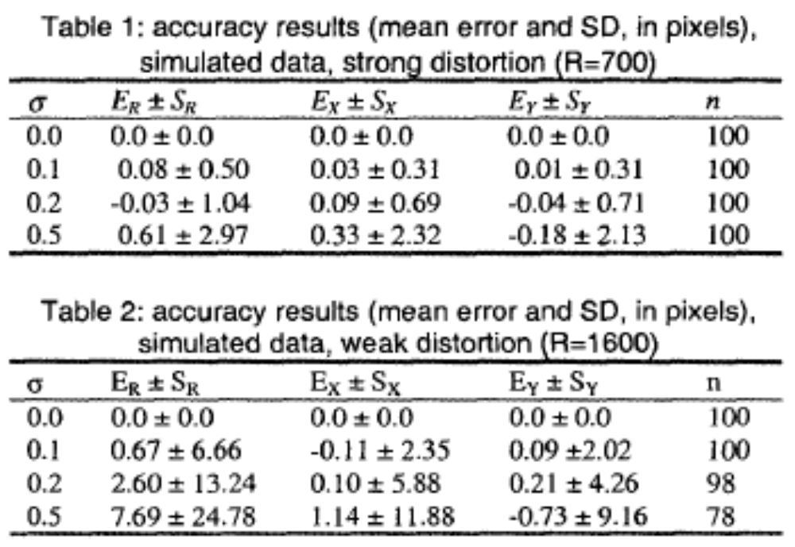
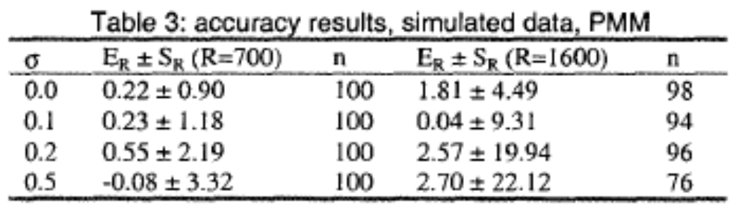
Results and Accuracy
standard deviation σ=0.0, 0.1, 0.2 and 0.5 pixels in x- and y-co-ordinate.
The mean errors of P=(X,Y) and R (E_{R}=R_{caic}-R, E_{x}=X_{calc}-X, E_{y}= Y_{caic}-Y) and standard deviations
(SD) (S_{R}, S_{x}, S_{y}) were determined.

Slide 13
The big advantage of our method is that a well distribution of the extracted image points over the whole image is not necessary.
In the very extreme case only three circles each represented by just three points are sufficient to determine the strong lens distortion.

